Slide 1
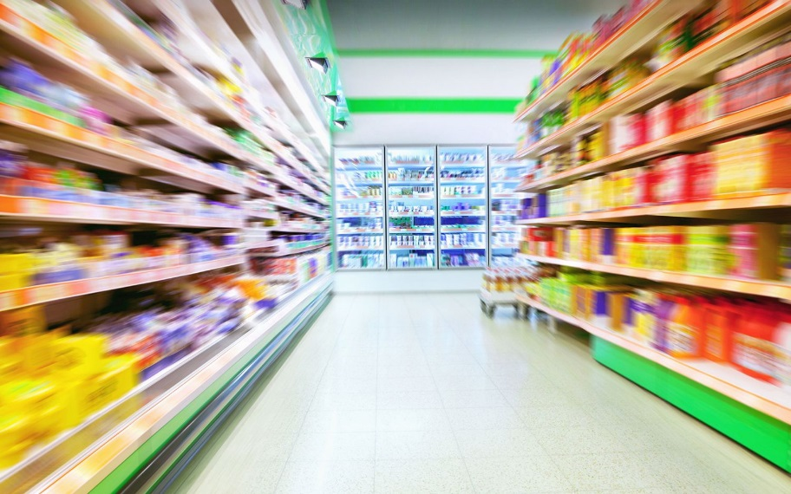
What Marketers Know
seventeen general “rules” of food merchandising that supermarkets use to enhance profits

Slide 2
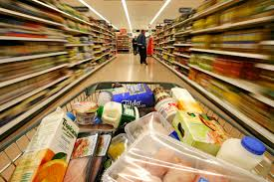
1. TIME = MONEY
The more time shoppers spend in a store, the more they buy. A basic tactic of the grocery game is to keep the customer shopping for as long as possible.

Slide 3
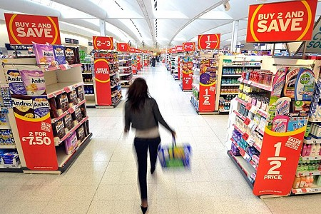
2. BARGAIN HUNTERS SPEND MORE
People intent on finding “bargains” so they can “save money” often spend more than casual shoppers. So a shopping environment that appears loaded with “bargains” tends to increase sales.
Coupon clippers and bargain hunters typically invest so much time and energy in shopping that they have to spend enough to “justify” their efforts.

Slide 4
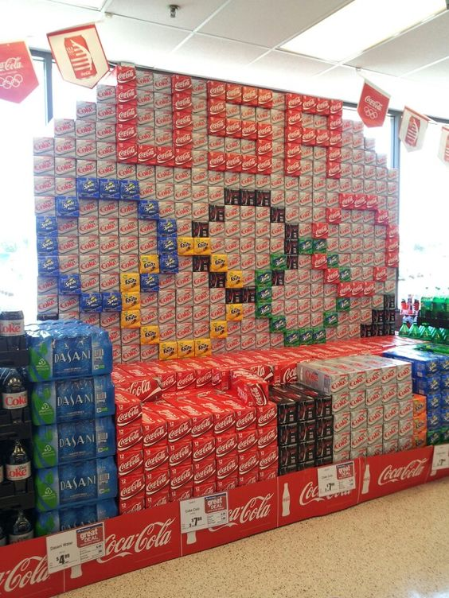
3. LOOKS SELL
What’s the best way to sell more produce? A huge, colorful display works great; even better than a modest price cut. A shiny, huge, bright red apple will sell faster than a more “homely” looking fruit that tastes better.

Slide 5
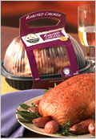
4. CONVENIENCE IS A PRODUCT
Convenience sells. Much of a shopper’s grocery bill pays for processing that makes the food easier to serve at home. Shoppers view even the smallest time saver as added value and are willing to pay for it.

Slide 6
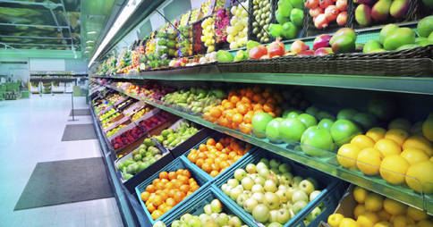
5. THE PERIMETER IS FOR PROFITS
The departments arranged along the outer walls of a store are often called “the power perimeter.” Departments such as produce, dairy, meat, and a deli usually produce far more profits than the packaged goods found in the interior aisles

Slide 7
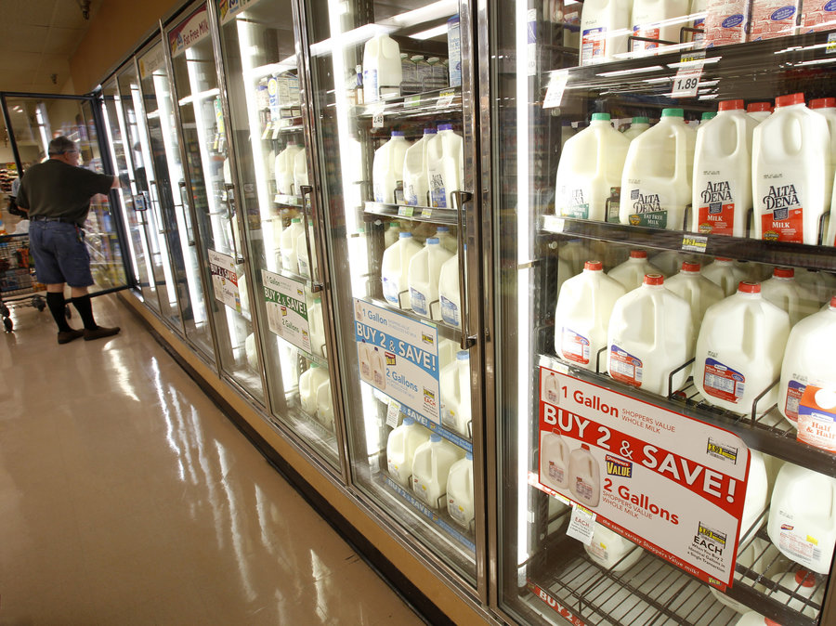
6. PULL SHOPPERS INTO THE STORE
Foods that appear most often on grocery lists (called “demand items”) are often placed at the rear of a store in order to use their pulling power to move shoppers past other merchandising temptations. It might be more convenient for a store to have milk and bread at the front of the store so some shoppers can get in and out quickly — but it would not be good merchandising.

Slide 8
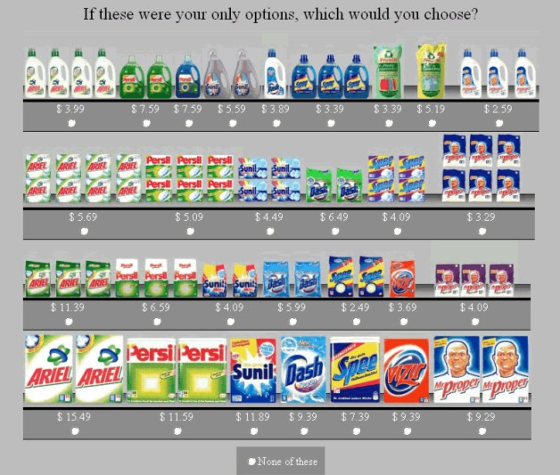
7, MOVE SHOPPERS PAST FACINGS
A “facing” is a display of a product on a shelf “one across.” Each facing has a column of packages behind it. If you see the faces of three Cheerios boxes on a shelf, that is three facings. In general, the more facings a product can display, the more it will sell.

Slide 9
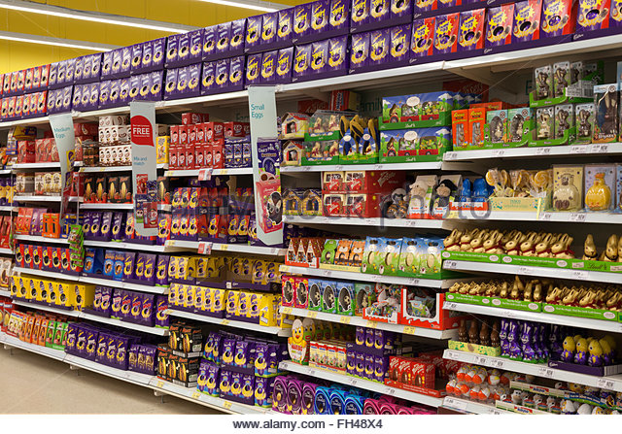
8. SHELF CONTROL WINS
The shelves look bright and colorful, but they are a battlefield where control for every square foot is a fight, and every percent increase in sales can be worth millions. Leading national supermarkets charge slotting fees to food makers as a sort of “shelf rental.”

Slide 10
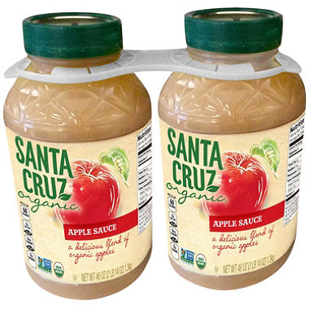
9. LOCATION, LOCATION, LOCATION
Marketers experiment constantly with shelf positions. One experiment increased sales of large jars of applesauce 500% by moving them from near the floor up to eye level. Marketers find the best possible location to maximize the profits for each square foot of shelf space.

Slide 11
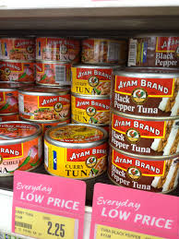
10. SHOPPERS DON’T KNOW PRICES
Sale items build traffic and help draw attention to higher profit impulse buys. Shoppers are familiar with prices of items they buy frequently, but not most of the thousands of other foods. A large sign with the price and words such as “special” or “special value” will increase sales even though the price is not a reduction.

Slide 12
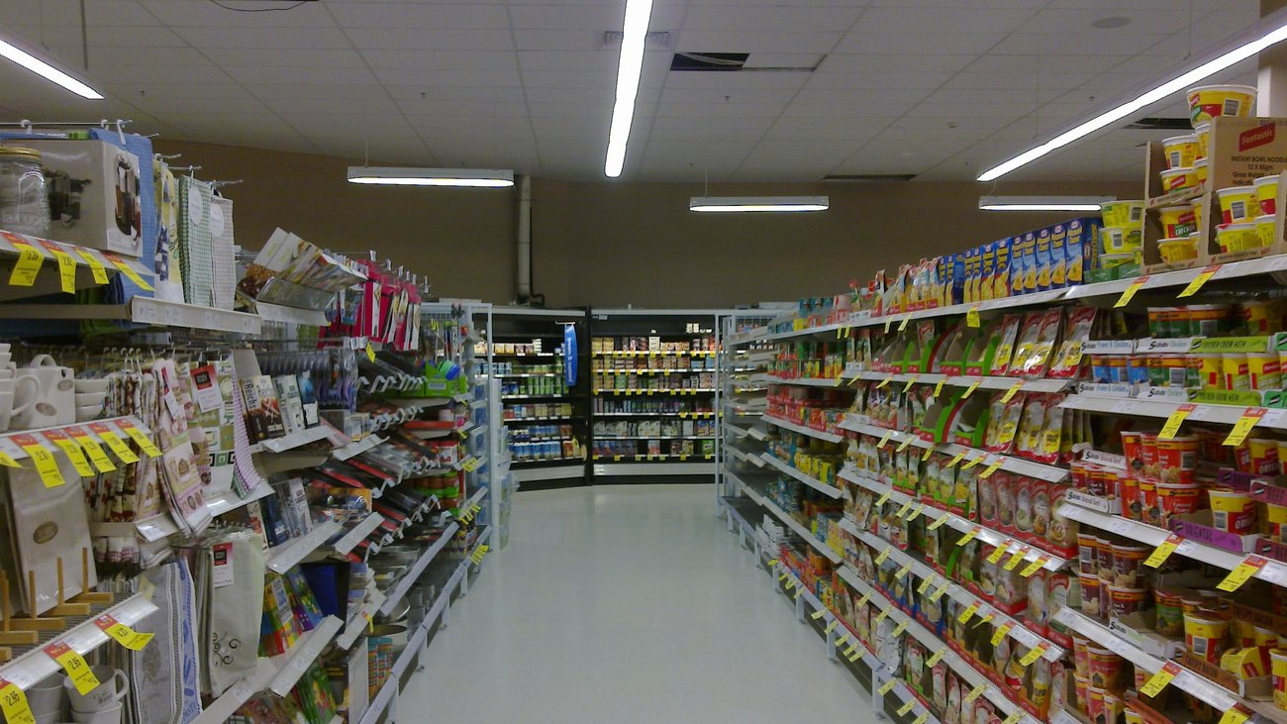
11. FAST TURNOVER WINS OVER HIGH PROFIT
Supermarkets depend on volume and a fast turnover.
Stores use mixed-margin pricing. That means the mix of sale and non-sale items remains steady.
The grocery business operates on narrow profit margins. A saying in the grocery business is “better a fast nickel than a slow dime.”

Slide 13
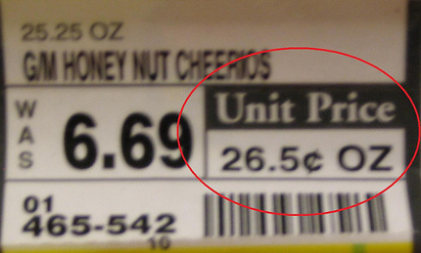
12. UNIT PRICES ARE A SHOPPERS FRIEND
Unit pricing allows shoppers to compare prices among different brands or sizes.

Slide 14
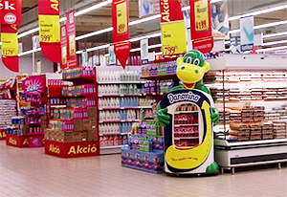
13. SLOW DOWN SHOPPERS
Special displays, often at the ends of aisles, keep getting in the way. That's how they work, by grabbing attention and slowing shoppers. Special displays slow shoppers so they don’t rush past merchandising offers. Displays that seem to block your way while shopping are often just that — blockers designed to slow traffic.

Slide 15
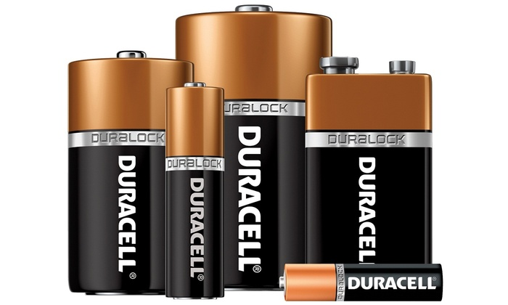
14. MAKE THE PAST OF LEAST RESISTANCE THE MOST PROFITABLE
Even bargain hunting shoppers will often follow the path of least resistance. Hundreds of non-food items from film to batteries are sold at higher than average prices in supermarkets.

Slide 16
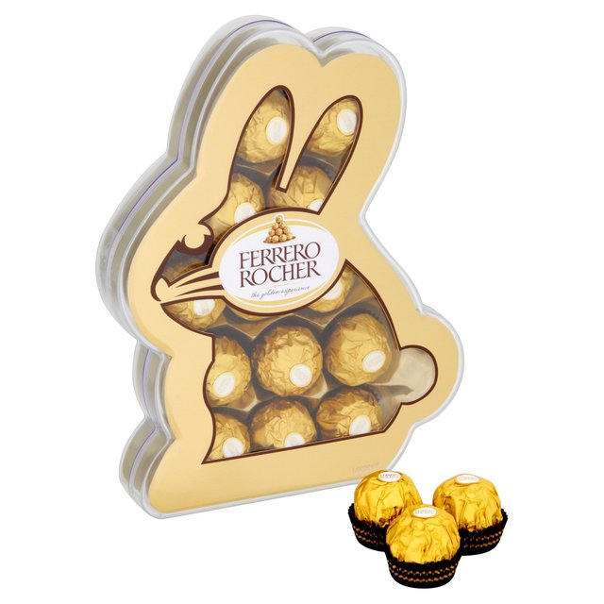
15. OFTEN THE PACKAGE IS THE PRODUCT
Sometimes the package costs more than what is inside. Marketers do not view packages as containers for food. They know that a package can actually be the main reason people buy the product.

Slide 17
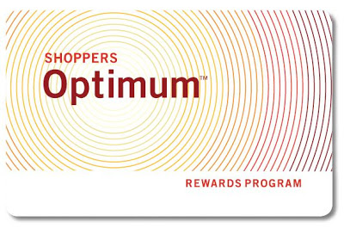
16. CUSTOMER INFORMATION IS VALUABLE
A loyalty card program does not lower prices for shoppers, but it does give the store information about buying habits. Customer information is a critical selling tool. Stores use the data gathered with these cards to control inventory and create targeted promotions.

Slide 18
17. SHOPPERS CAN WIN
Hundreds of little moves help grocers win the game. But if you understand some of “what marketers know” about how food is merchandised, you will make better choices and win the game.

