Slide 1
Vitamins
Nutrition 2102
Unit 1

Slide 2
Basic Facts:
Vitamins are found in nearly all the foods in the Food Guide.
Vitamins do not provide energy
They are essential because they regulate the body chemistry and body functions.

Slide 3
Basic Facts con’t
Vitamins cannot be produced by our bodies.
They must be ingested or eaten in our food.
Vitamins assist the body in using food by
bringing about biochemical reactions.

Slide 4
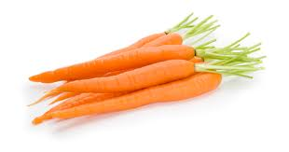
Groups of Vitamins
Fat-soluble vitamins are transported through the body by being carried and stored in fat.
A, D, E, K

Slide 5
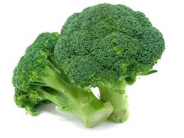
Groups of Vitamins
Water-soluble vitamins are transported through the body by being dissolved in water
C, B complex, Folacin

Slide 6
Too Little, Too Much?
Too few vitamins keep the body from operating at full capacity
Too many vitamins may be damaging to your health: they will be excreted or stored, and an excess can be toxic.

Slide 7
Types of Vitamins
A
D
E
K
C
B Complex
B1: Thiamine
B2: Riboflavin
Niacin
Folacin
B6: Pyridoxine
B12: Cobalamin

Slide 8
Vitamin Basics
Function: the job or responsibility of the vitamin.
Source: what foods contain the vitamin
Prevention: how the vitamin can help your body.

Slide 9
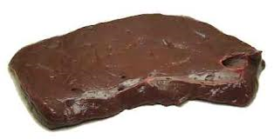
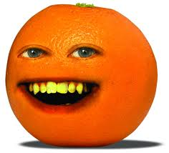
Example: Vitamin A
Function: good vision and healthy skin
Prevents:
night blindness
poor eyesight
poor skin, hair
Sources:
Liver
Carrots
Oranges

