Slide 1
Minerals
Nutrition 2102
Unit 1

Slide 2
Basic Facts:
Minerals are found in nearly all the foods in the Food Guide.
Minerals do not provide energy
They are essential because they regulate the body chemistry and body functions.

Slide 3
Basic Facts con’t
Minerals cannot be produced by our bodies.
They must be ingested or eaten in our food.
There are about (60) different minerals that make up about (4%) of our bodies.

Slide 4
Groups of Minerals
Macrominerals found in relatively large amounts.
calcium,
phosphorus,
sodium,
potassium

Slide 5
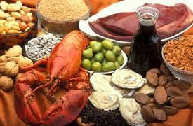
Groups of Minerals
Trace minerals found in very small amounts.
iron,
zinc,
fluorine,
copper,
iodine

Slide 6
Too Little, Too Much?
Too few minerals keep the body from operating at full capacity
Too many minerals may be damaging to your health: they will be excreted or stored, and an excess can be toxic.

Slide 7
Types of Minerals
Sodium
Calcium
Potassium
Chloride
Phosphorus
Magnesium
Fiber
Copper
Iodine
Iron
Zinc
Selenium
Fluorine

Slide 8
Mineral Basics
Function: the job or responsibility of the mineral.
Source: what foods contain the mineral
Prevention: how the mineral can help your body.

Slide 9
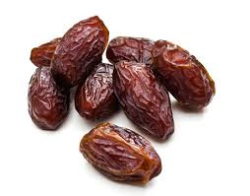
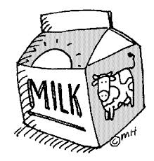
Example: Calcium
Function: Helps bones, teeth, blood serum, clotting, muscles, nerves
Prevents:
Osteoporosis
Weak teeth
Sources:
Dates
Milk
Spinach

